Slide 1
Lecture 11 Dimensionality Reduction
EE-uy 4563 / EL-Gy 9123: Introduction to machine learning
Prof. gustavo sandoval with material from Victor Lavrenko and Andrew Ng.

Slide 2
Dimensionality Reduction
Motivating Examples
Feature Selection
Feature extraction via PCA
Examples

Slide 3
Data Compression
Less features:
Speeds up Algorithms
Reduces space used by data
What is it?
You have collected many features – maybe more than you need
Can you simplify your data set in a rational and useful way?

Slide 4
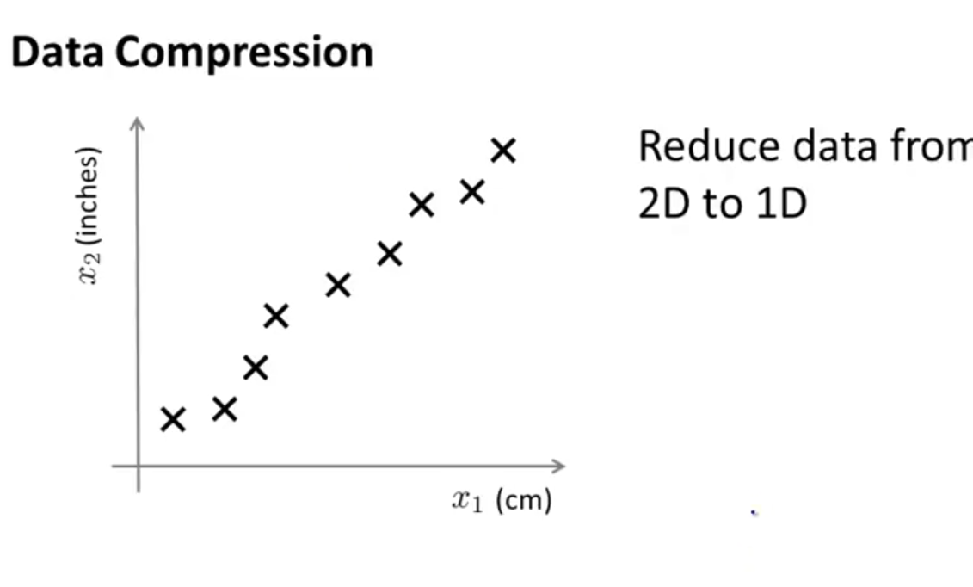

Slide 5
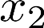
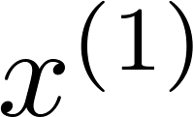
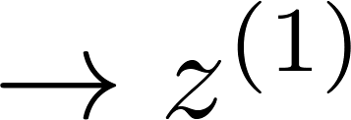
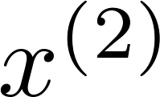
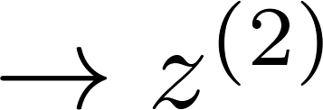
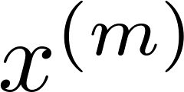
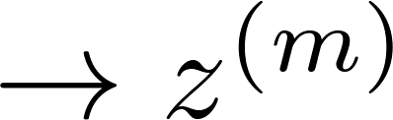

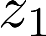
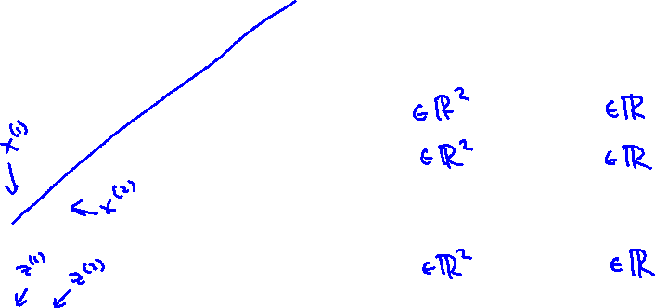
Data Compression
Reduce data from
2D to 1D
(inches)
(cm)
Notes:
In this case I went from R2 to R2 and I just need one number
We project into the green line and then we only need one line.
It’s an approximation but I only need to keep around only one number.
This allows your algos to run faster.

Slide 6
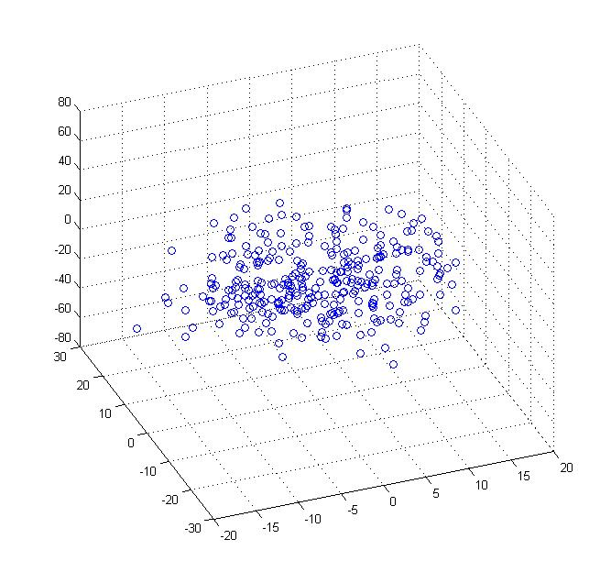
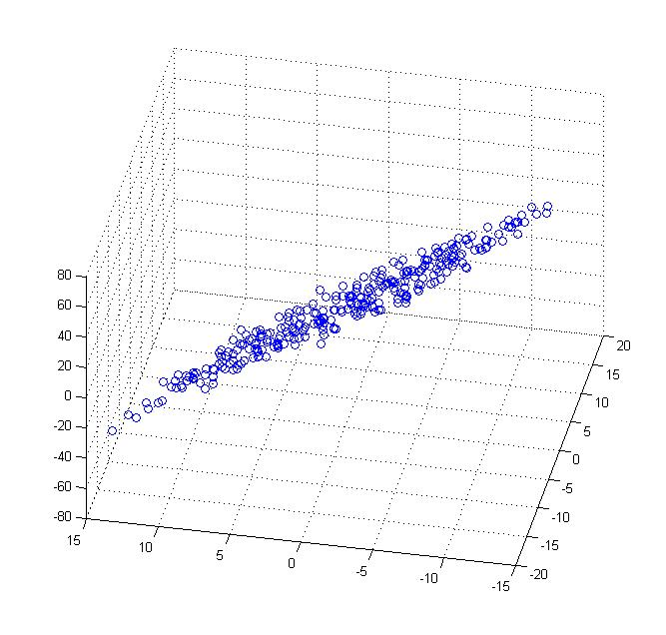
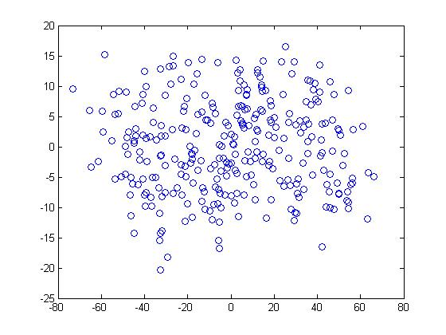
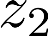
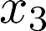
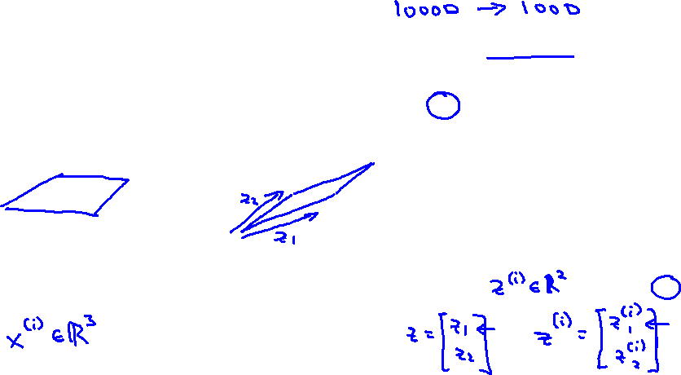
Data Compression
Reduce data from 3D to 2D
Notes:
Pca3d2d in lecture-slides/assets/pca/
Label axes

Slide 7
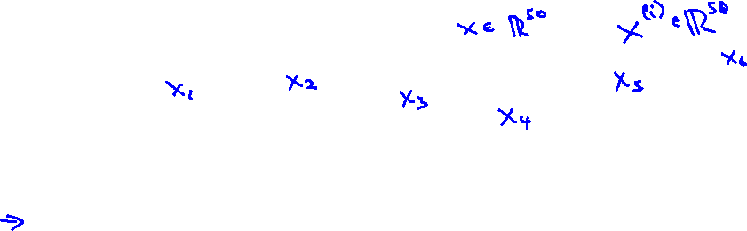
Data Visualization
Country | GDP (trillions of US$) | Per capita GDP (thousands of intl. $) | Human Develop-ment Index | Life expectancy | Poverty Index (Gini as percentage) | Mean household income (thousands of US$) | …
Canada | 1.577 | 39.17 | 0.908 | 80.7 | 32.6 | 67.293 | …
China | 5.878 | 7.54 | 0.687 | 73 | 46.9 | 10.22 | …
India | 1.632 | 3.41 | 0.547 | 64.7 | 36.8 | 0.735 | …
Russia | 1.48 | 19.84 | 0.755 | 65.5 | 39.9 | 0.72 | …
Singapore | 0.223 | 56.69 | 0.866 | 80 | 42.5 | 67.1 | …
USA | 14.527 | 46.86 | 0.91 | 78.3 | 40.8 | 84.3 | …
… | … | … | … | … | … | …
[resources from en.wikipedia.org]
Notes:
Add dots

Slide 8
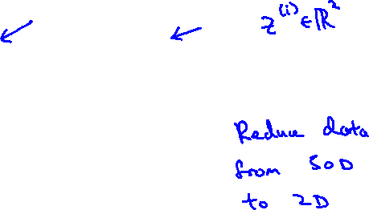
Data Visualization
Country
Canada | 1.6 | 1.2
China | 1.7 | 0.3
India | 1.6 | 0.2
Russia | 1.4 | 0.5
Singapore | 0.5 | 1.7
USA | 2 | 1.5
… | … | …

Slide 9
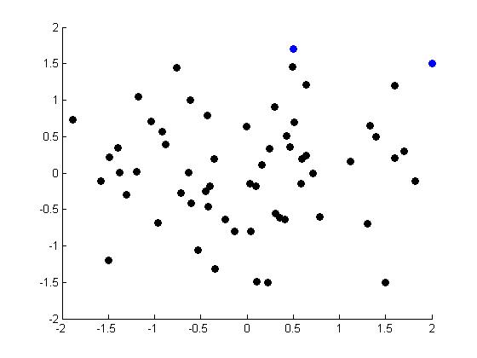
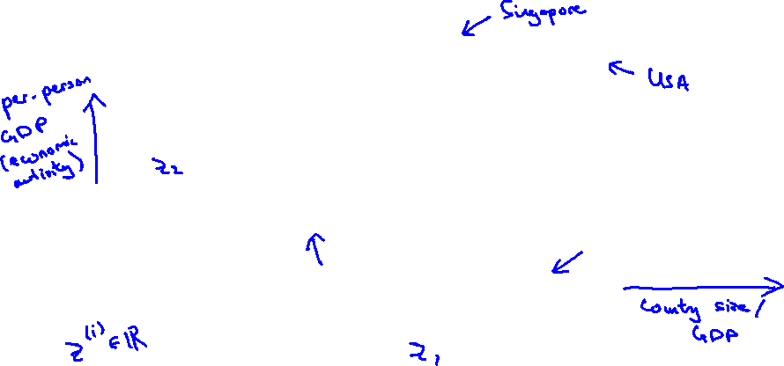
Data Visualization
Notes:
Make points look uncorrelated
US, Singapore in blue

Slide 10
Goals
Reduces time complexity: Less computation
Reduces space complexity: Less parameters
Saves the cost of observing the feature
Simpler models are more robust on small datasets
More interpretable; simpler explanation
Data visualization (structure, groups, outliers, etc) if plotted in 2 or 3 dimensions
Notes:
Complexity depends on the numbe of input dimensions, d as well as the data sample

Slide 11
Dimensionality Reduction
Motivating Examples
Feature Selection
Feature extraction via PCA
Examples

Slide 12
Feature Selection
Feature selection:
Choose k<d important features,
Ignore remaining d – k
Hope good subset with k << d

Slide 13
Subset Selection
We are not sure what k should be
We hope to find a good subset with k << d
One option:
Suppose our main concern is accuracy
For all subsets S of the features, train using just the features in S.
Test the learnt hypothesis on the validation set

Slide 14
Subset Selection
Forward search:
Add the best feature at each step
Set of features F initially Ø.
At each iteration, find the best new feature
j = argmini E ( F È xi )
Add xj to F if E ( F È xj ) < E ( F )
Backward search: Start with all features and remove one at a time, if possible.
Notes:
For each feature x in S train using feature set S υνιον {x}
Test on validation set.
If accuracy obtained in validation set with each of the S υνιον {x} is always less than the accuracy with just S alone Stop

Slide 15
Dimensionality Reduction
Motivating Examples
Feature Selection
Feature extraction via PCA
Examples

Slide 16
Feature Extraction
Feature extraction:
Project the original x_{i} , i =1,...,d dimensions to new k<d dimensions, z_{j} , j =1,...,k
Going from points in d dimensional space to points in k dimensional space.
Methods:
Principal components analysis (PCA),
linear discriminant analysis (LDA),
factor analysis (FA)

Slide 17
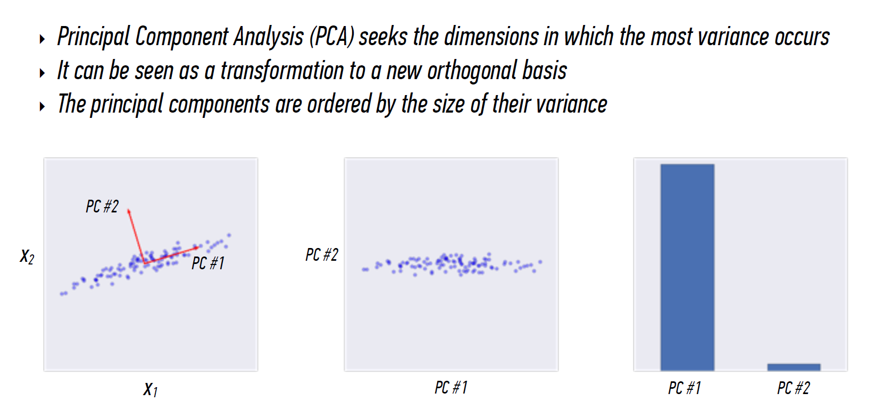
PCA

Slide 18
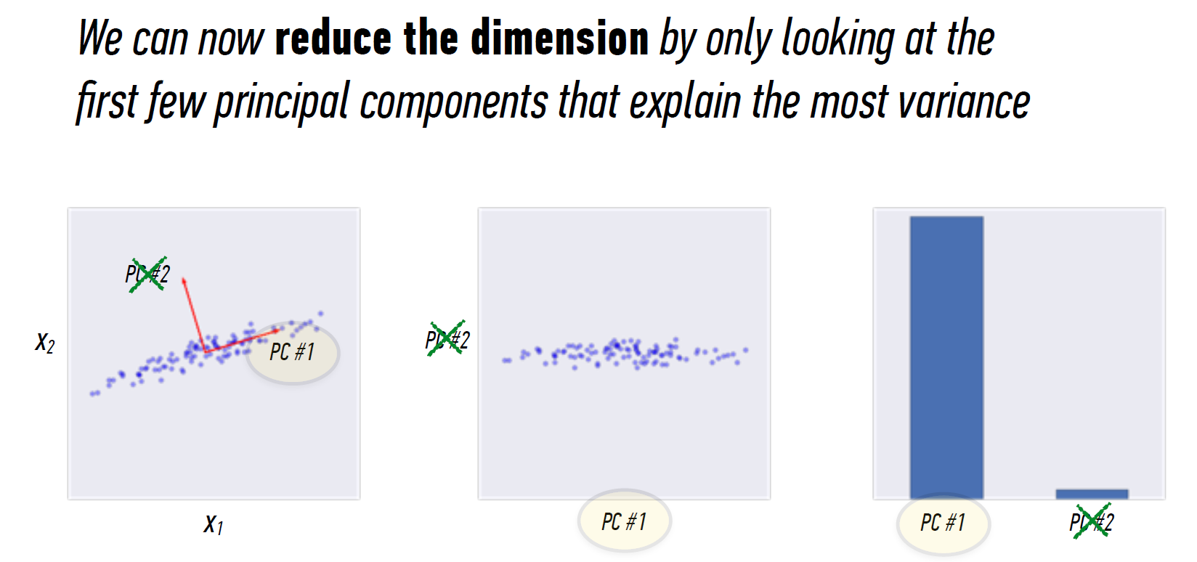

Slide 19
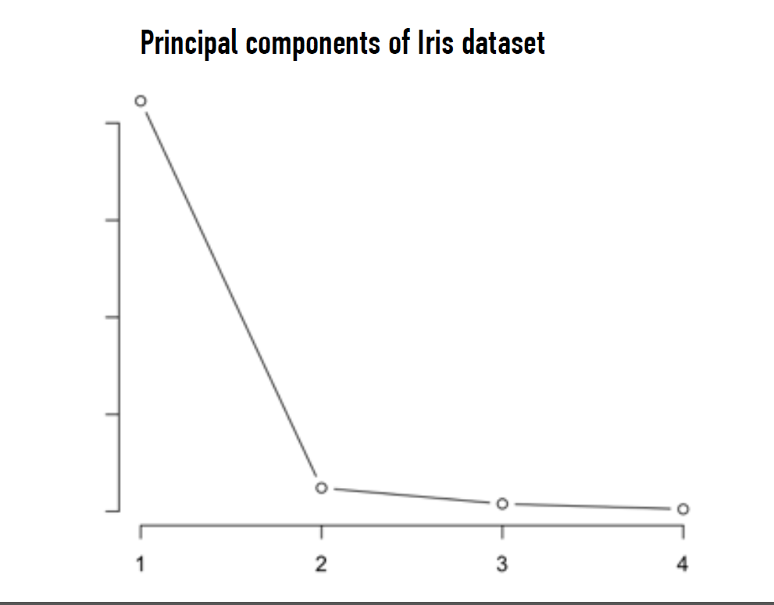
Notes:
Looking at this plot also gives you an idea of how many principal comonents to keep.
Apply the elbow test keep only those pcs that appear on the left of the elbow

Slide 20
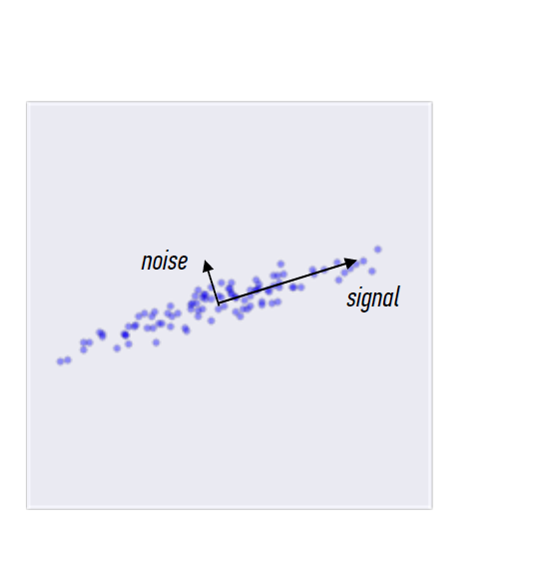
PCA
Principal Component Analysis seeks the dimensions in which the most variance occurs
It can be seen as a transformation to a new orthogonal basis, ordered by variance
The idea is that the first principal components contain the most information, while the later ones contain noise.

Slide 21
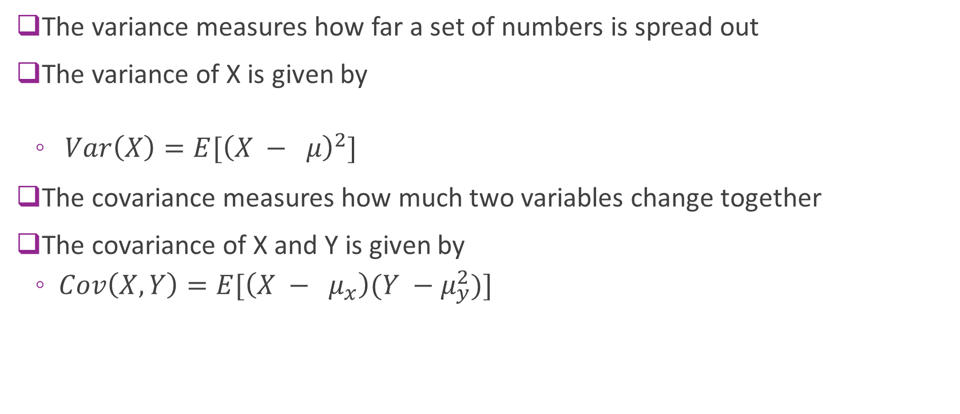
Covariance matrices (aside)
The variance measures how far a set of numbers is spread out
The variance of X is given by
${Var\left(X\right)=E[{\left(X − μ\right)}^{2}]}_{}$
The covariance measures how much two variables change together
The covariance of X and Y is given by
${Cov\left(X,Y\right)=E[{\left(X − μ_{x}\right)(Y −μ_{y}^{2})]}^{}}_{}$

Slide 22
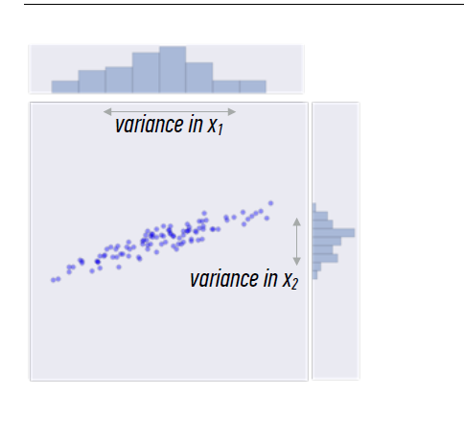
Variance
Recall that variance measures how far a set of numbers is spread out.
Covariance measure how much two variables change together.

Slide 23
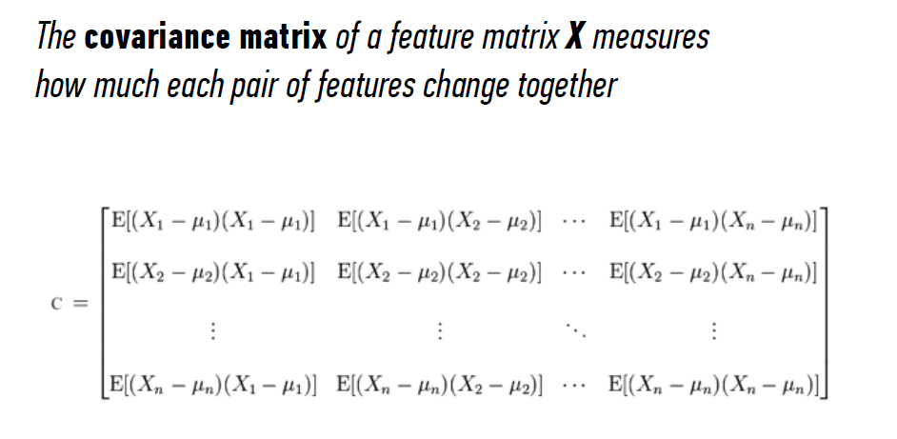
Covariance Matrix

Slide 24
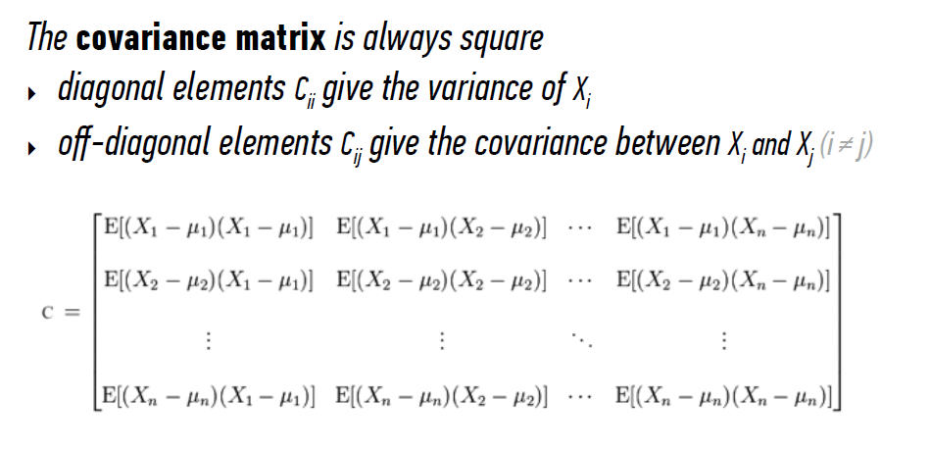
Covariance Matrix

Slide 25
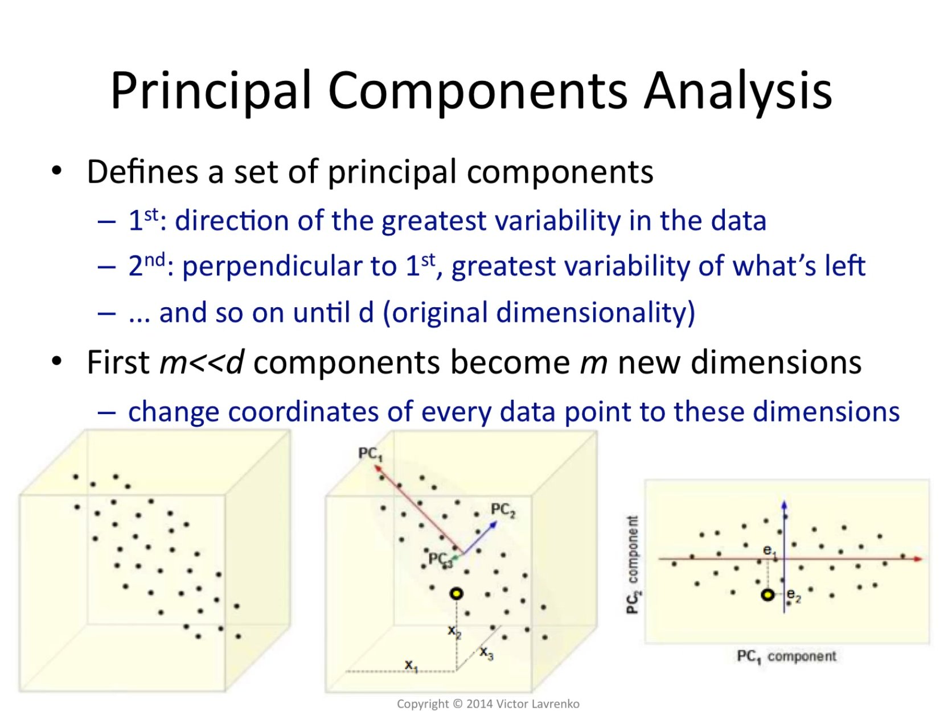
Notes:
Red vector is the where the data is spread out the most
Blue one is where the second most, and so on.
Ida of PCA
Look for the direction the greatest variance =>
Look fo the ones that’s perpendicular and has the greatest remaining variance. ..
Then changed the coordinates to use those.
Project the points to those new dimension

Slide 26
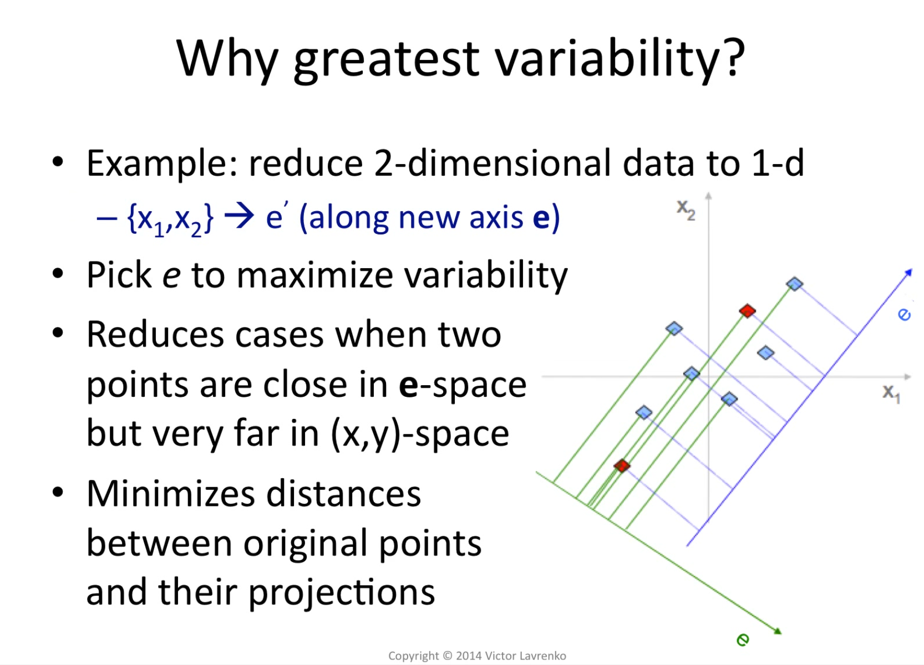
Notes:
The dimension where the data is spread out the most is gonna keep the biggest variability.

Slide 27
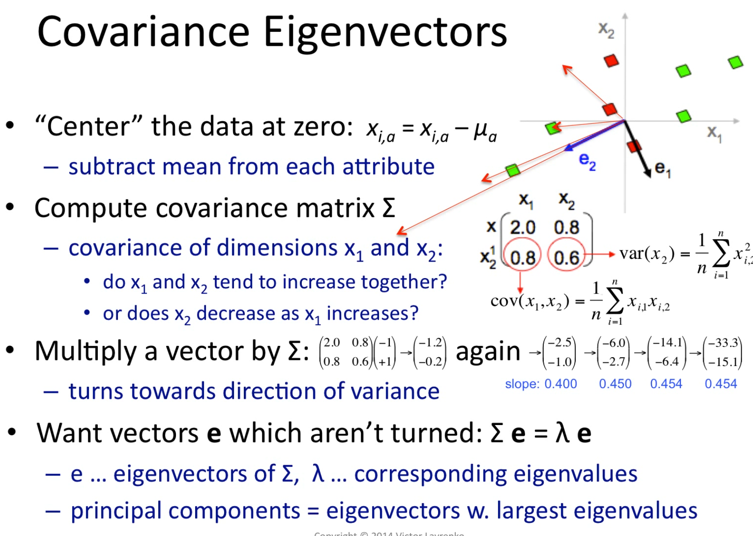
Notes:
Green go the same direction

Slide 28
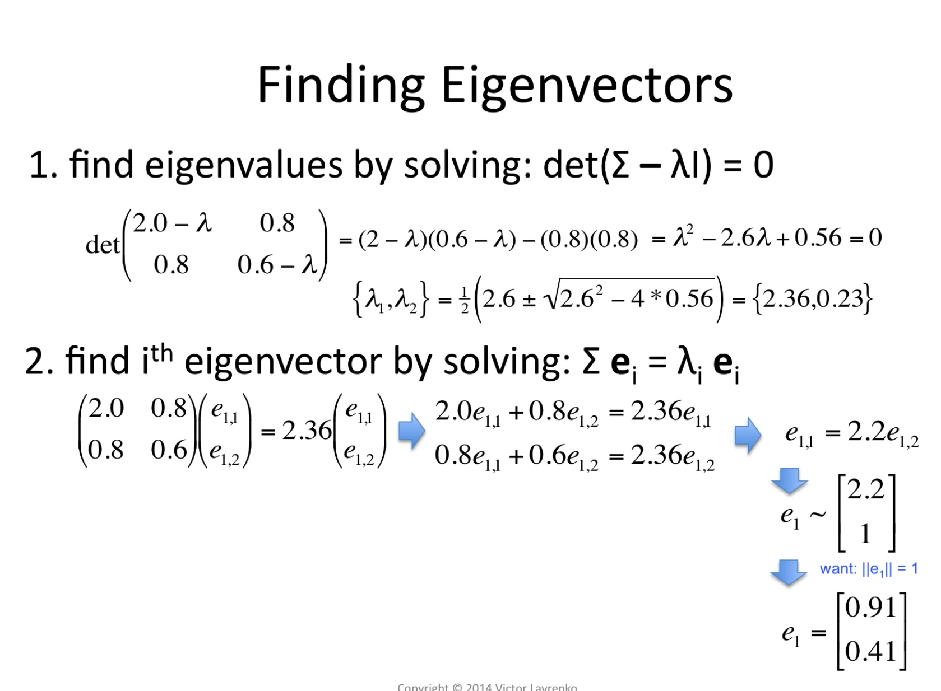
Notes:
A few of you might have seen this in Linear Algebra
Find eigenvalues of sigma(the covariance matrix)
You want the vectors to be unit legth
Divide by eucledian length and get 0.91 and 0.41

Slide 29
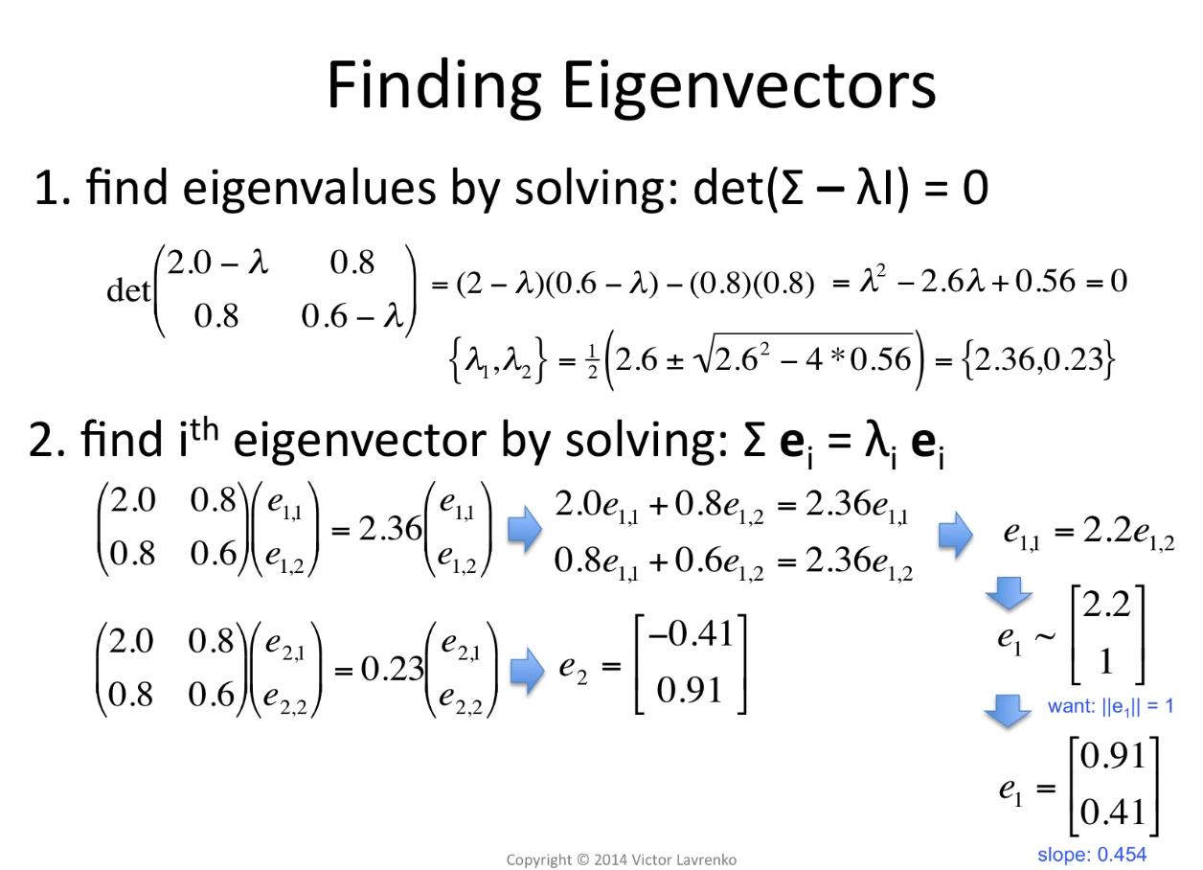

Slide 30
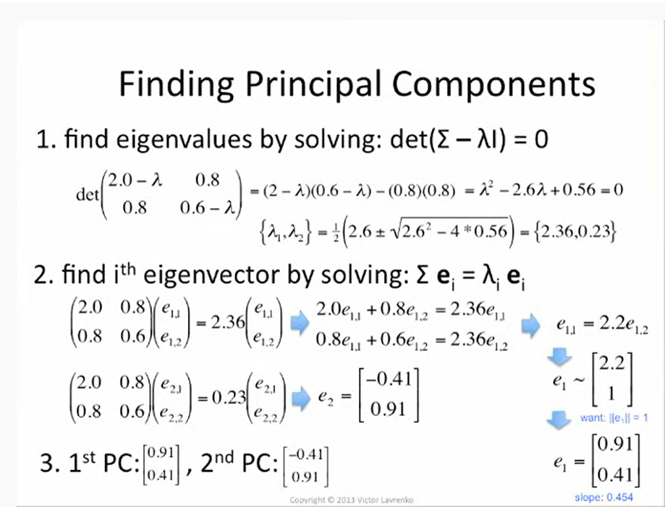

Slide 31
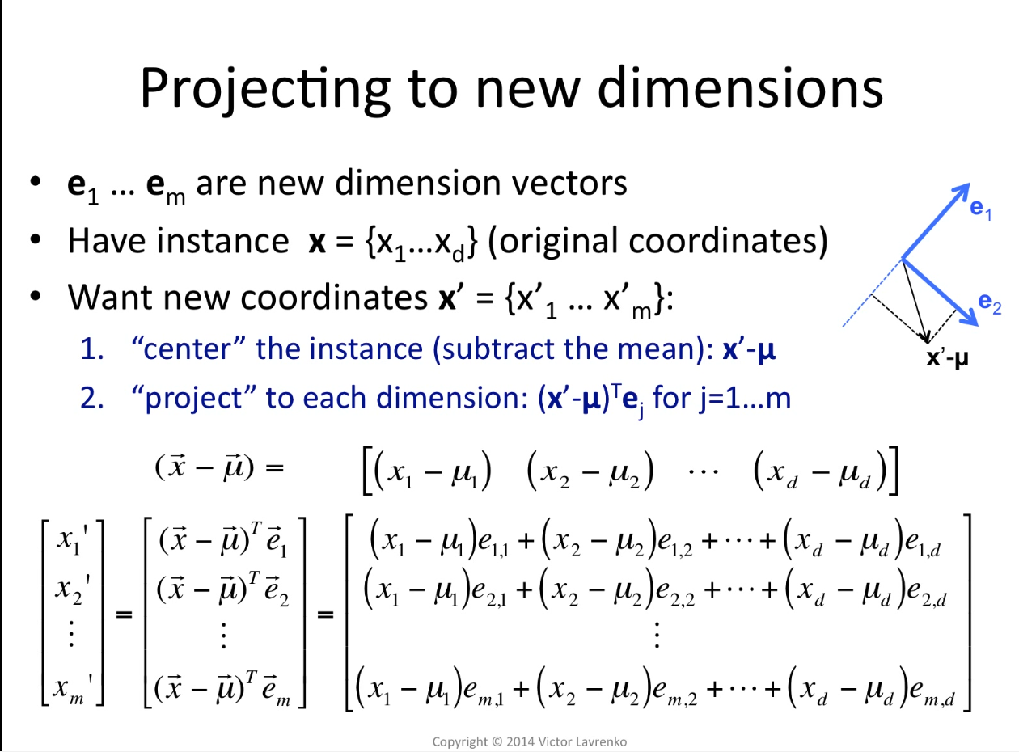
Notes:
Project to each dimension
X1 prime is the new cooridinate.

Slide 32
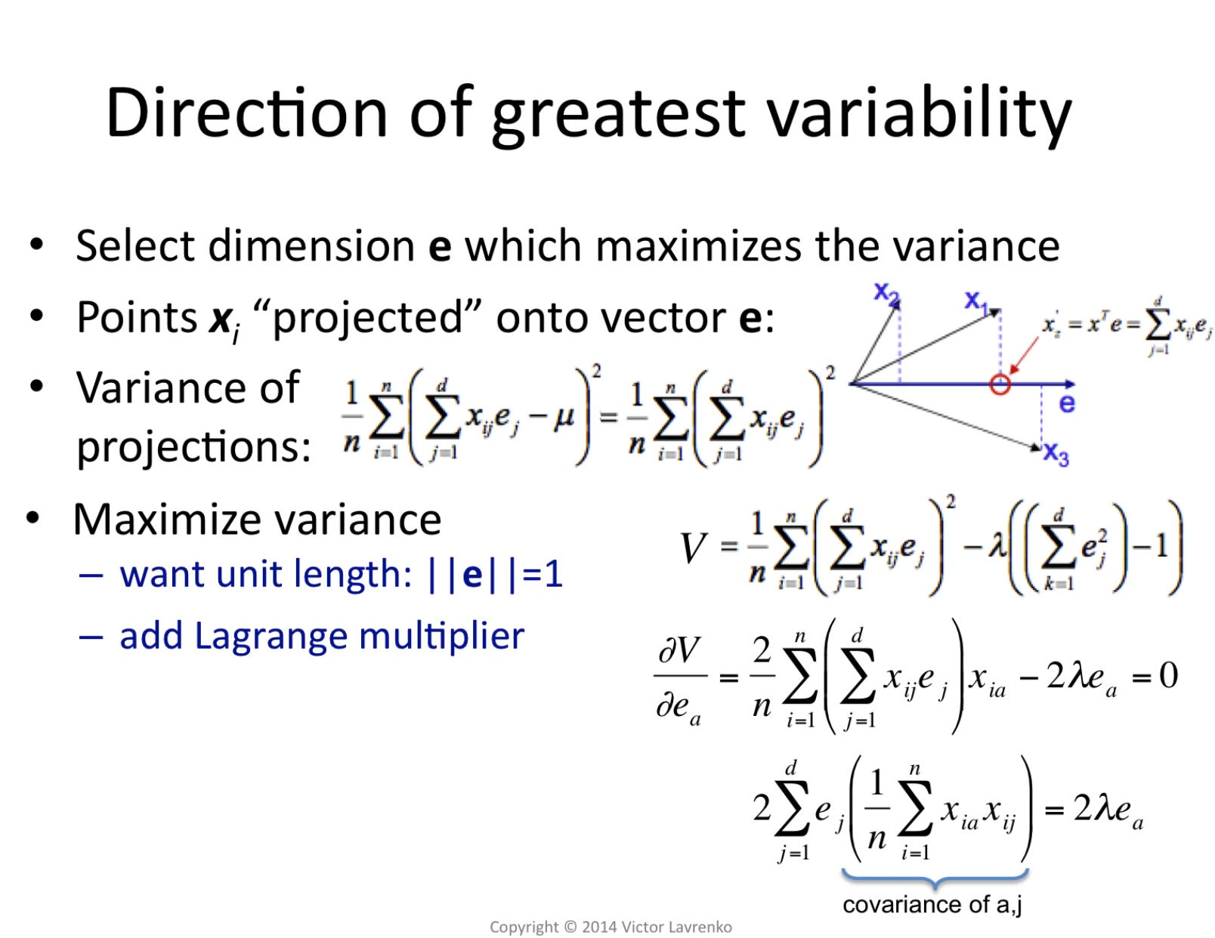
Notes:
We are gonna be looking for the eigenvectors
Constrained optimization
Second term becomes a lagrange multiplier because we want e to be at most 1
Then derivative

Slide 33
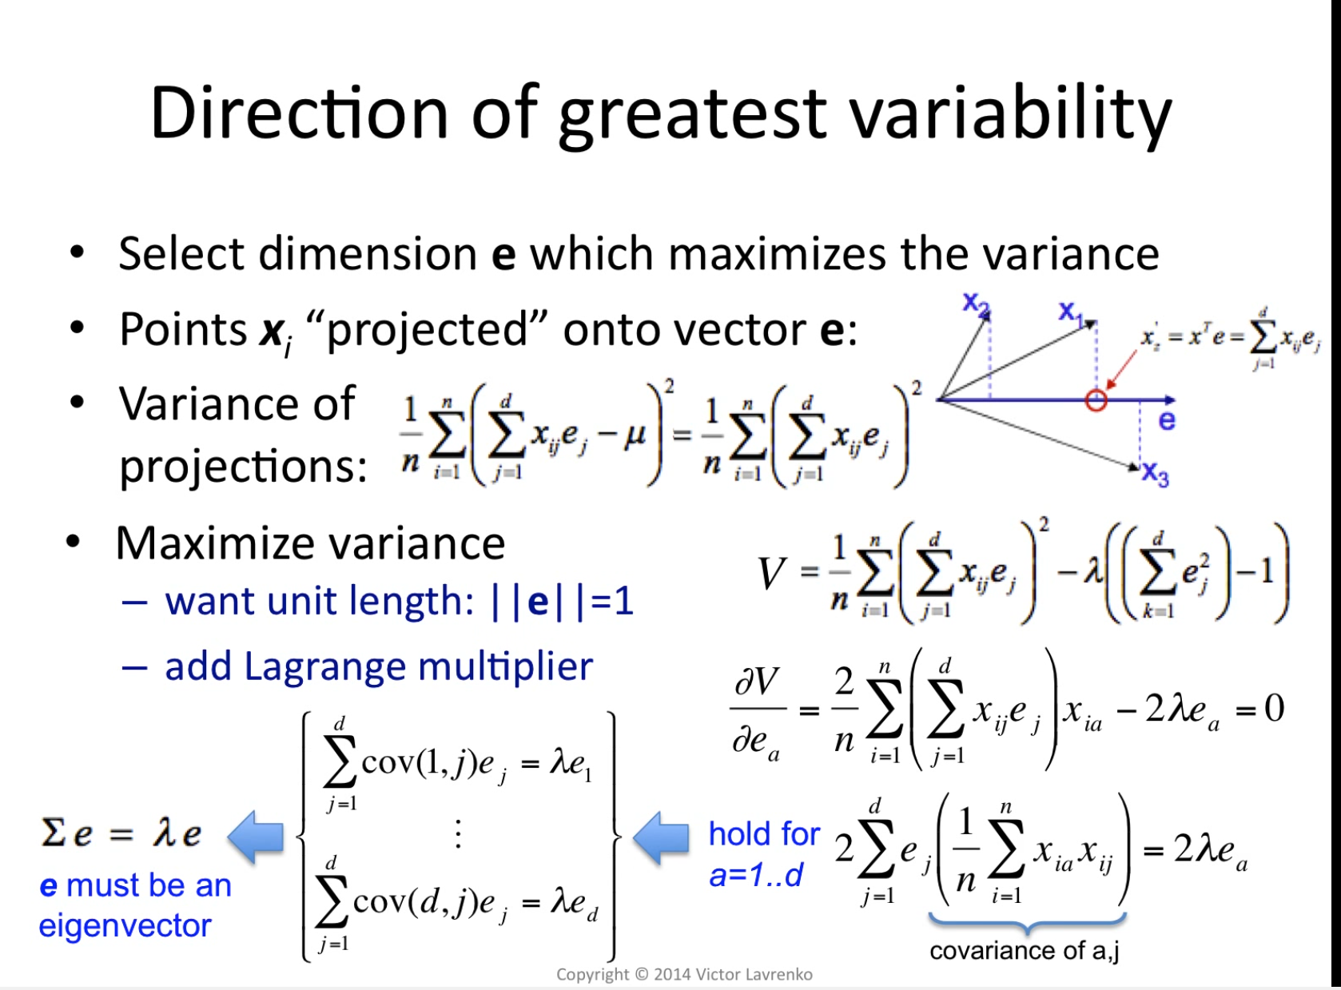

Slide 34
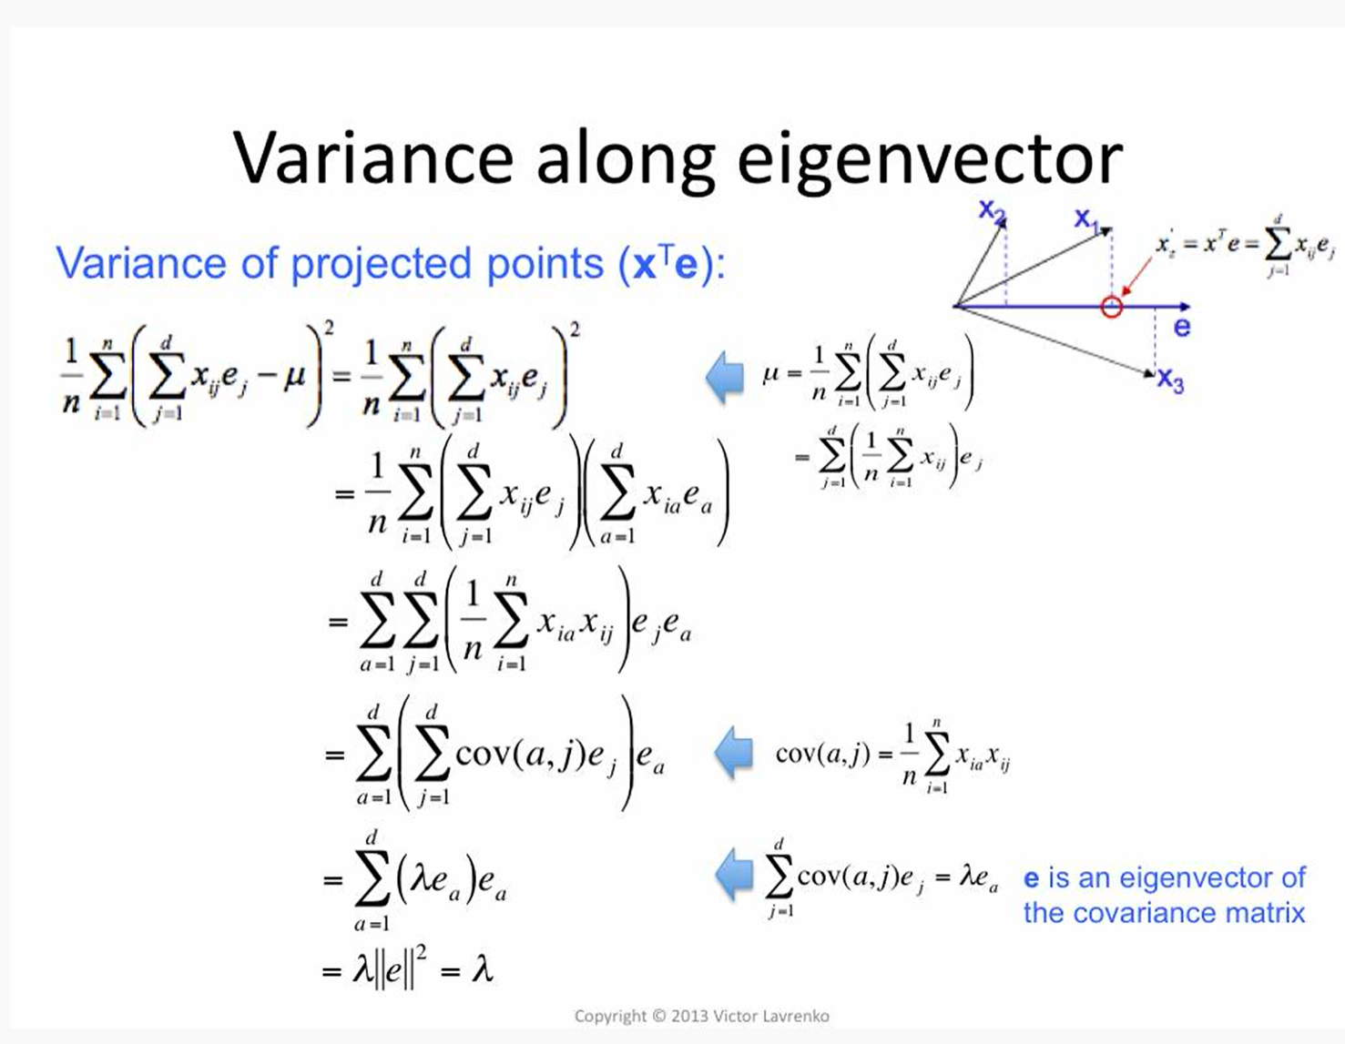
Notes:
Here we proved that the variance along the eigenvector is the eigenvalue.

Slide 35
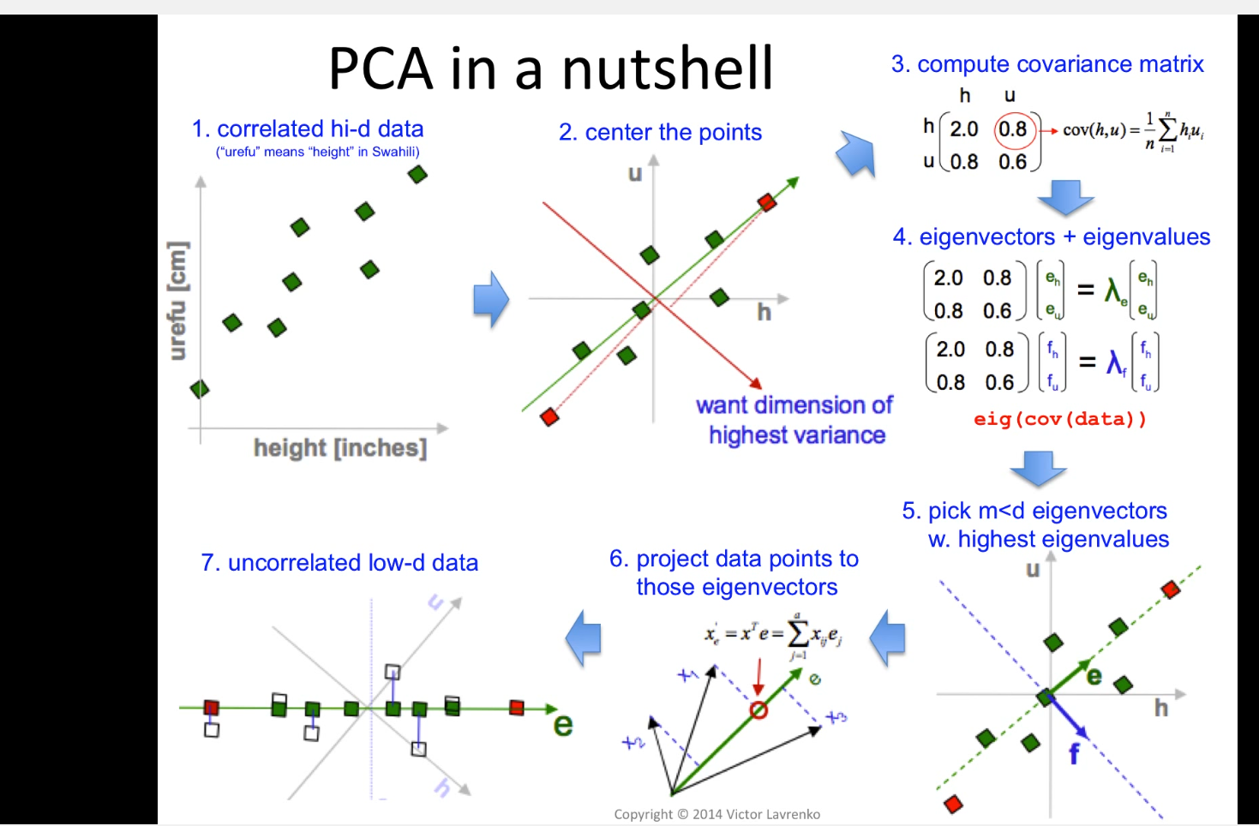

Slide 36
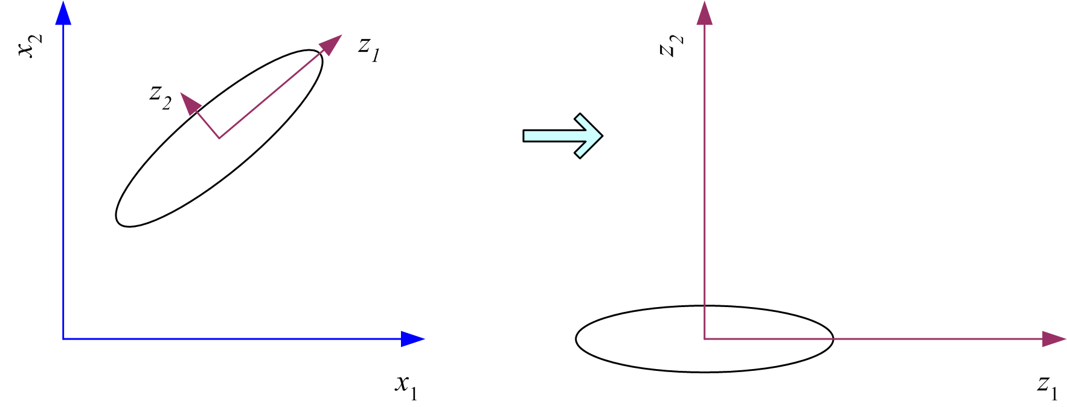
What PCA does
z = W^{T}(x – m)
where the columns of W are the eigenvectors of ∑, and m is sample mean
Centers the data at the origin and rotates the axes
Notes:
Here we project to 2 dimensions:
Given z1 find orthogonal z2 tz that maximizes the sample variance

Slide 37
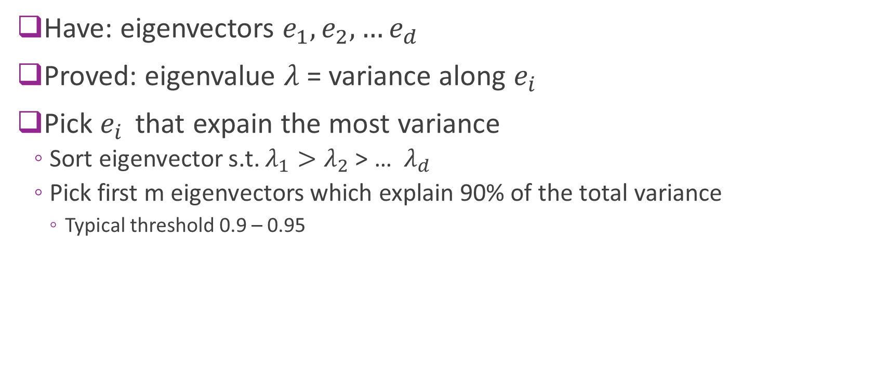
How many dimensions
Have: eigenvectors $e_{1}, e_{2},…e_{d}$
Proved: eigenvalue $λ$= variance along $e_{i}$
Pick $e_{i }$ that expain the most variance
Sort eigenvector s.t. $λ_{1}>λ_{2}$ > … $λ_{d}$
Pick first m eigenvectors which explain 90% of the total variance
Typical threshold 0.9 – 0.95

Slide 38
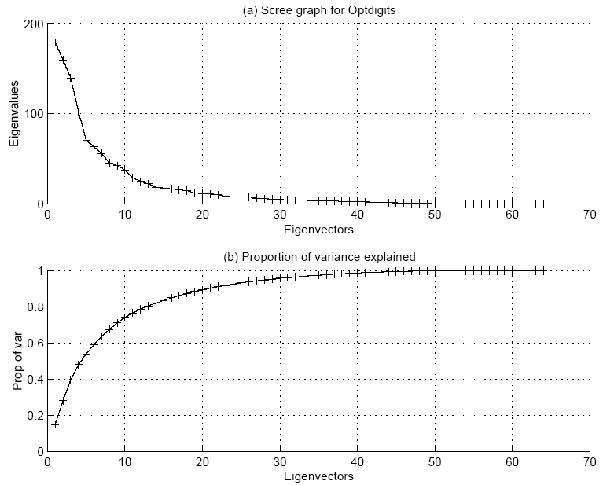

Slide 39
Other Data Preprocessing

Slide 40
Discretization of Continuous Attributes
Why?
Allows use of algorithms using discrete features
May make more sense to quantize
How to do it?
Local methods – over subset of data, as in decision tree algorithms
Global methods – over whole dataset
Supervised and unsupervised (use labels, or don’t)
Produce k-valued attribute, or multiple binary attributes
Adapted by L. Hellerstein Spring 2012 from Lecture Notes for E Alpaydın 2010 Introduction to Machine Learning 2e © The MIT Press (V1.0)
11

Slide 41
Making discrete attributes continous
Need to be careful doing this for nominal attributes
Nominal means no ordering on attribute values
E.g. Attribute has value in set {NY, MI, CA}
Encoding with single value causes value ordering
Instead, have 3 binary indicator variables
For ordered discrete attributes, still problematic
Distance between values may not be accurate
Adapted by L. Hellerstein Spring 2012 from Lecture Notes for E Alpaydın 2010 Introduction to Machine Learning 2e © The MIT Press (V1.0)
12

Slide 42
Simple Data Transformations
Normalization of attributes can be important
Creating simple, meaningful new features
Difference of two date attributes
Ratio of two numbers
Encoding cluster membership
Adapted by L. Hellerstein Spring 2016 from Lecture Notes for E Alpaydın 2010 Introduction to Machine Learning 2e © The MIT Press (V1.0)
13

Slide 43
Dimensionality Reduction
Motivating Examples
Feature Selection
Feature extraction via PCA
Examples

Slide 44
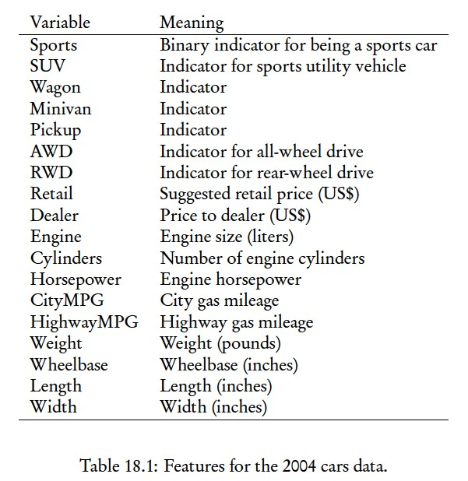

Example: Reducing dimensionality of Car Data
388 cars (examples); 18 features,
11 numerical
Numerical features. Will only use these. Thus n = 11.

Slide 45
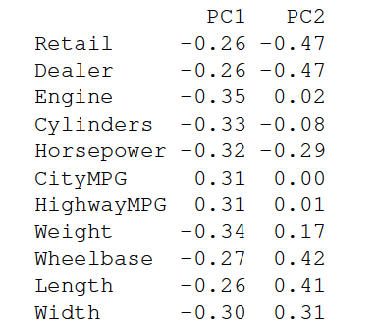
Each principal component is a linear combination of original features.
First principal component tells us about whether we are getting a big, expensive gas-guzzling car with a powerful engine, or whether we are getting a small, cheap, fuel-efficient car with a wimpy engine.
Second principal component: Large if car is big, inexpensive, weak. Small if car is small, expensive, powerful (minivans vs. sports cars)
From: Advanced Data Analysis from an Elementary Point of View by Cosma Rohilla Shalizi
Notes:
This says that all the variables except the gas-mileages have a negative projection on to the first component.
. This means that there is a negative correlation between mileage and everything else.

Slide 46
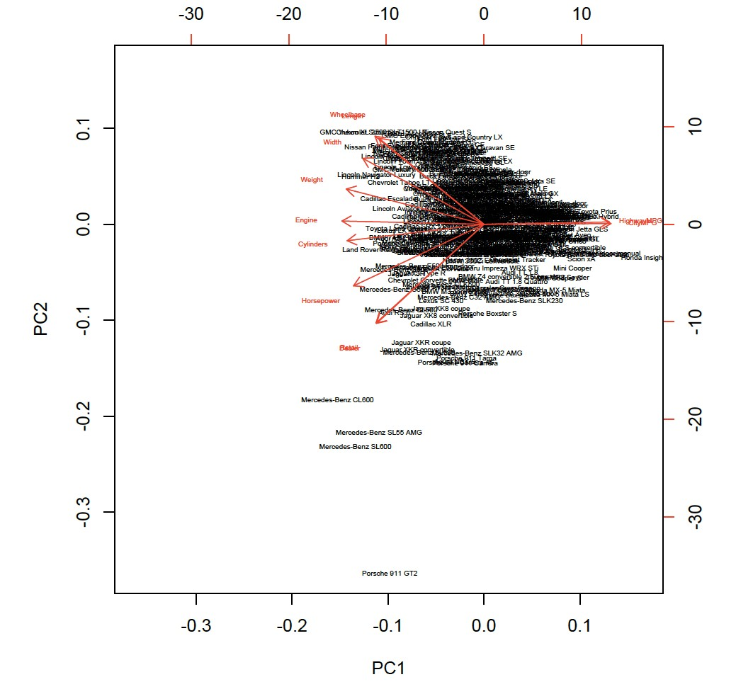

Figure shows PC values for each of the 388 cars.
Also shows projections of original features onto the two PCs.
Notes:
The horizontal axis shows projections on to the first principal component
The vertical axis the second component
Car names are written at their projections on to the coponents
Red arrows show the projections of the original variables on to the principal components (using the scales on the bottom and on the left)’

Slide 47
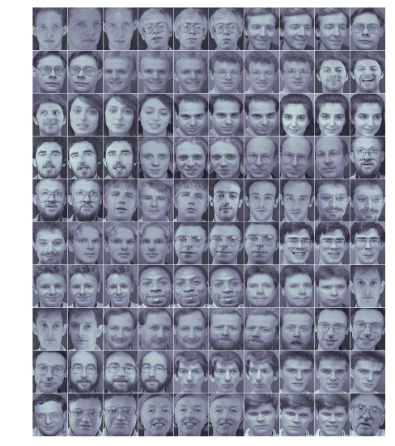
Eigenfaces: Each image is an example.
Each pixel value is
a feature. Dimension of feature vector is the # of pixels.
Here, 100 images of 34 people.

Slide 48
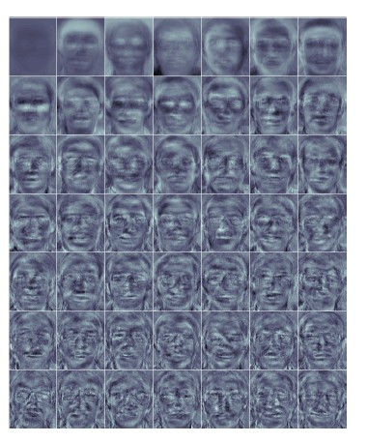
Mean and first 48 principal components.
Dimension of each principal component
is also number of pixels.
So can look at image associated
with a principal comp

Slide 49
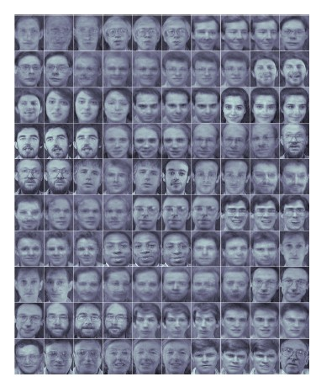
Each of the original images is now projected to the first 47 principle components. Each image corresponds to adding together (weighted versions of)
the principal components:

